Slide 1
Using artificial neural networks to detect unknown computer Worms
Prof.Sherafat
M.E. Salavati
8861841003

Slide 2
Abstact
A new approach to detect the presence of computer worms
Compare ANN to three other classification methods
Show the advantages of ANN for detection
Evaluate three feature selection techniques→using only five features we get accuracy of 90%

Slide 3
Introduction
Malware programs
Antiviruses use signature
A different approach by analyzing the overall computer behavior
Apply a trained artificial neural network based on the values of the measured features
Compare the detection capabilities of new approach to other approaches
Causal indices (CI) technique to estimate the influence of each input feature on the classification of each worm

Slide 4
Main Advantages of ANN
High level of efficiency in real-time operations
Low consumption of CPU resources
Ability to generalize

Slide 5
Related work
Malicious software
Pieces of code,not only executable files, which intend to cause harm
Malicious codes :
Worms
Viruses
Trojans
remote access Trojans
There are no good worms that break into systems .
Worms propagate actively over networks without intervention.
Worm does not necessarily require a host file .

Slide 6
Classification methods
General description
Supervised learning have trouble detecting new classes(new worms)→hidden neurons’ rounded outputs as cluster signatures
Auto-Associative ANN (AA-ANN)→same data for input and output
Semi-supervised approach

Slide 7
Levenberg–Marquardt ANN training method for training AA-ANN
New worm → new binary pattern(similar or not similar)
Detection and classification

Slide 8
1.Classification by clustering
Analyzing the outputs of the hidden neurons instead of the outputs of the output neurons
For each sample ,a new binary pattern.
All samples belong to a cluster
cluster matrix → each row: a cluster
each column: a know class
Cells in each row represent the number of samples in the cluster that belong to a specific class
The class of each cluster is defined by the label of the majority of samples in the cluster.

Slide 9
2. Decision trees
Good choice when involves classification or prediction of outcomes
Can also provide a measure of confidence that the classification is correct
The advantages of the DT :
its short training and classification times
simple rules can be extracted

Slide 10
3.k-nearest neighbors
KNN method looks for most similar existing examples to the new one
Similarity may be based on feature values or on some different similarity measure
4. Support vector machines
For linear, binary classification with margin
Margin stands for the minimal distance between the class separating hyperplane and the closest data point
General SVM seeks an optimal separating hyperplane that maximizes the margin

Slide 11
Feature selection methods
1) Hidden neurons’ relative variance:
Ranking the inputs (features) according to their relevance to the prediction accuracy of the ANN
In a trained ANN model, a less relevant input contributes a smaller proportion of the variance in the activities of the hidden layer neurons.
2) Fisher’s score ranking:
Calculate the difference, described in terms of mean and standard deviation, between positive and negative examples relative to a certain feature

Slide 12
3) Gain ratio ﬁlter
Is based on the information gain (IG) measure, which is found by measuring the relative entropy reduction.
4) Causal indices analysis:
Enables the identiﬁcation of the relationships between speciﬁc inputs and outputs of an ANN model through trained ANN connection weights
Identify the effect of the speciﬁc computer system measure on the identiﬁcation of a known worm

Slide 13
The worms used to create the data sets
Different behaviors and internal structures
Different types of worm→ different behavioral patterns
W32.Dabber.A:
Randomly scans IP addresses
Upload itself onto the victim computer→ self-carried worm
Adds itself to the registry
Listens in on a predefined port or scans other ports until it finds an unused port that it can exploit

Slide 14
2. W32.Deborm.Y:
Self-carried worm
Uses local address optimization while scanning the IP addresses.
Registers itself as an MS Windows service .
Adds itself to the registry.

Slide 15
3. W32.Sasser.D:
Uses local address optimization while scanning the network for victim computers
Scans the local addresses half of the time and totally random addresses the other half of the time .
Heavy impact on a computer’s CPU usage

Slide 16
4. W32.HLLW.Doomjuice.B
Randomly generates IP addresses.
Tries to connect to other computers using a specific TCP port.
Adds itself to the registry.
Worm runs a continuous denial of service (DoS) attack on the Microsoft website.

Slide 17
5. W32.HLLW.Raleka.H
Uses local address optimization while scanning the network for vulnerable computers.
Opens a random TCP port for remote connections.
Receive commands from its chat site.
Opens a chat server on the computer.

Slide 18
Description of data sets
Inject worms
Monitor various computer features
MS Windows performance tool
A dataset consisting of 68 features
No Worm→ “clean”
Creating dataset with two aspects:
User activity
Background application activity

Slide 19
Evaluating the new approach
Compare the detection abilities.
Multiple classifications of known worms using ANN approach and the base line classifiers: KNN, DT, and SVM.
Investigate the capabilities of new approach in detecting unknown worms.
Determine the best feature selection technique for this task.

Slide 20
Rank the features of feature selection method.
For each feature selection method, we used the top 5, top 10, top 20, top 30, top 50, and full set of features as inputs to the ANN model.
For the training set, we took 10% of randomly chosen instances, excluding the instances of the worm we chose and also excluding 20% of the clean instances.
For the test set for each worm, we took the instances of the chosen worm and the 20% of the clean instances that were excluded from the training set.

Slide 21
Experimental results
ANN:
best speed in the classification phase
Ability to identify a new worm
The Fisher’s score method outperformed the other techniques in feature selection

Slide 22
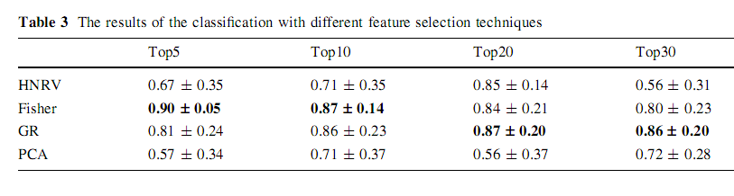
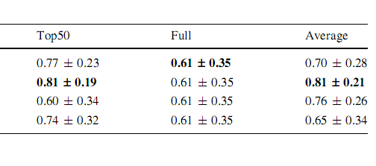

Slide 23
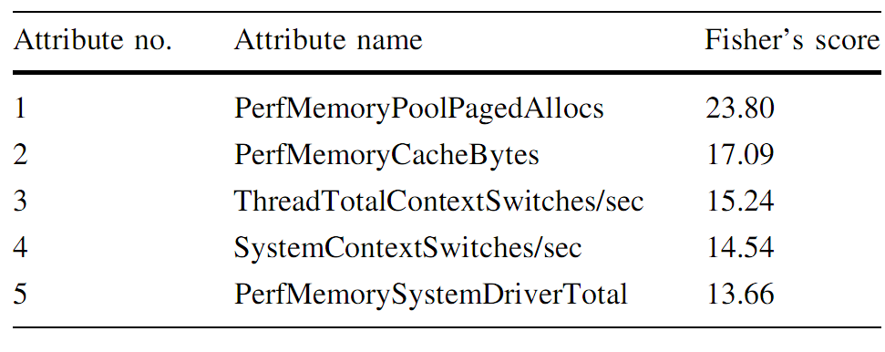
Top 5 Features of Fisher’s Score

Slide 24
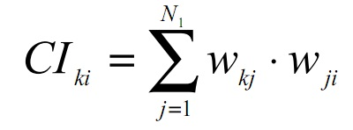
Causal Index
Causality Index (CI) measures the dependence of a neural network output on each of its inputs
Measures average dependence of output node k on input node i
Positive CI →increase in input→increase in output
Negative CI→ increase in input→decrease in output

Slide 25
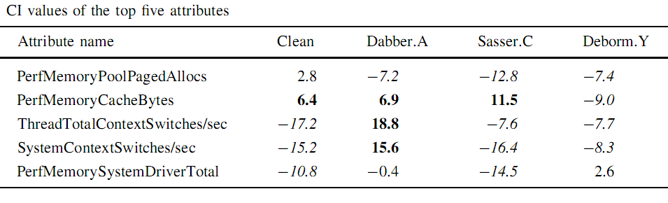
CI values were calculated from the ANN model that used the five best features
If feature 2 is high and features 3, 4, 5 are low, then clean
If features 2, 3 and 4 are high and feature 1 is low, then DabberA
If feature 2 is high and features 1, 3, 4, 5 are low, then SasserC
If features 1, 2, 3 and 4 are low, then DabormY

Slide 26
What I did
Three methods:
CI matrix
Hidden neuron binary values
Competetive neural network

Slide 27
Data I used
Using 5 features selected by Fishers’ score ranking
Memory\Cache Bytes
Memory\Pool Paged Alloc
Memory\System Driver Total Bytes
System\Context Switches/sec
Thread(_Total/_Total)\Context Switches/sec
data clean : max: 1) 68370432 2) 358205 3)3018752 4)98930.0344693213 5)98900.9193879870
Min: 1)62709760 2)49911 3)2920448
4)584.040975807398 5)64.0076063936973

Slide 28
Data Dabber.A
max: 1)79347712
2)75877
3)30187524
4)820972.068899300
5)821282.073078985
Min: 1)68546560
2)70770
3)3018752
4)2842.89126250075
5)2202.47776657960

Slide 29
Data Deborm.Y
Max: 1)42528768
2)34222
3)2215936
4)18004.0751450754
5)17999.0745687102
Min: 1)40128512
2)31499
3)2117632
4)92.0109937994122
5)22.0025979225595

Slide 30
Data Sasser
Max: 1)65003520
2)58087
3)3018752
4)19481.1577408496
5)19481.1577408496
Min: 1)60571648
2)54441
3)2920448
4)523.875282435250
5)15.0599589958104

Slide 31
Data Doomjuice
Max: 1)50696192
2)51310
3)2215936
4)25968.8647443930
5)25966.8646007688
Min: 1)40206336
2)34262
3)2117632
4)571.062115862074
5)498.053598907057

Slide 32
Data Raleka
Max: 1)56668160
2)56308
3)2215936
4)15769.7261898734
5)15760.6816107433
Min: 1)49414144
2)41755
3)2215936
4)398.386989547988
5)401.412713519238

Slide 33
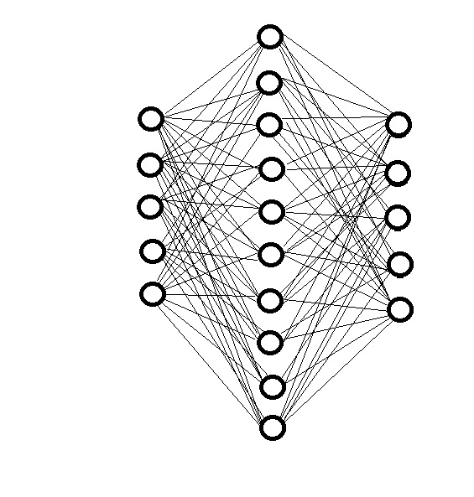
CI Matrix
CI_{5x5}

Slide 34
Finding the CI matrix:
b=data_clear(1:500,:)'/1000;
net = newff(b,b,10);
net.layers{2}.size=5;
net.trainParam.epochs = 20;
net.trainParam.max_fail=30;
[net,tr] = train(net,b,b);
y=sim(net,b);
for i=1:5
for k=1:5
for j=1:10;
CI(i,k)=sum(net.IW{1,1}(j,i).*net.LW{2,1}(k,j)');
end
end
end

Slide 35
Hidden neuron binary values
For each sample find a binary value of hidden neurons.
Create a matrix of hidden neurons values.
Compare new values with created matrix
HNV_{nx5}

Slide 36
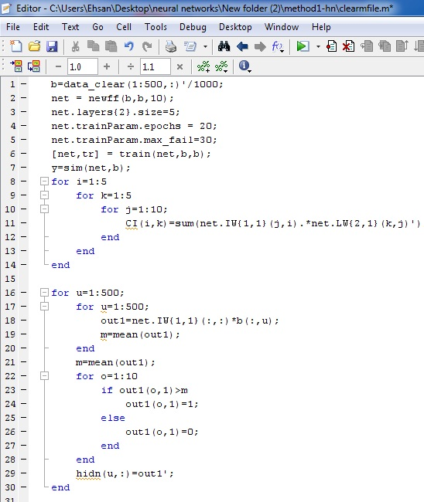

Slide 37
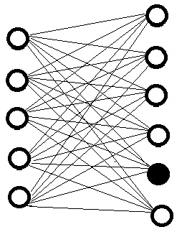
Competetive neural network
A competetive neural network
For each class only one neuron wins

Slide 38
x=data_raleka;
input_neurons=1:5;
output_neurons=1:10;
weights=rand(10,5);
for k=1:10
weights(k,:)=weights(k,:)/sum(weights(k,:));
end
itrnum=500;
output1=zeros(itrnum,10);
g=.5;
for k=1:itrnum
tempoutput1=weights*x(k,:)';
[c,i]=max(tempoutput1);
output1(k,i)=1;
weights(i,:)=weights(i,:)+g*(x(k,:)/sum(x(k,:))-weights(i,:));
end

Slide 39
Summary and discussion
New approach based on ANN for analyzing computer behavior data and detecting the presence of computer worms
The advantages of new approach:
ability to classify correctly a worm
good detection of new behavior of a known worm
short classification time
The accuracy of worm detection may increase when the detection process uses only the most important features
The Fisher’s score→a good feature selection method

Slide 40
My Conclusion
Detecting worms with ANN is possible.
Using only five computer features is enough in detecting worms behavior.
Hidden neurons’ binary values can be used for worm detection.
Competitive neural networks can also be used in worm detection.

Slide 41
Thanks for Your Attention

